Slide 1
MCA Final Year Project (Review II) AI-Driven Fraud Detection: Securing Banking Transactions
Submitted to the Presidency University, Bengaluru in partial fulfillment for the award of the degree of Master of Computer Applications(MCA)
Project Number : 212
Under the supervision of
Mr. Sakthi S Asst. Prof, Department of SCSE School of Computer Science and Engineering
Name | Roll Number
Vijita Narayan Nayak | 20232MCA0211

Slide 2
Content
Problem Statement
Literature Survey
Tools and Technologies to be used
Github Link
Timeline of the Project
References

Slide 3
Problem Statement
Rising Fraud Threat: Financial fraud in banking leads to significant monetary losses and reduced customer trust.
Limitations of Current Systems: Traditional rule-based methods fail to detect evolving fraud patterns, causing false positives and undetected fraud.
AI-Powered Detection : Machine Learning models analyze transaction patterns in real time to identify anomalies and predict fraudulent activities.
Enhanced Security & Accuracy: The AI-driven system improves fraud detection efficiency, minimizes false alarms, and secures banking transactions.

Slide 4
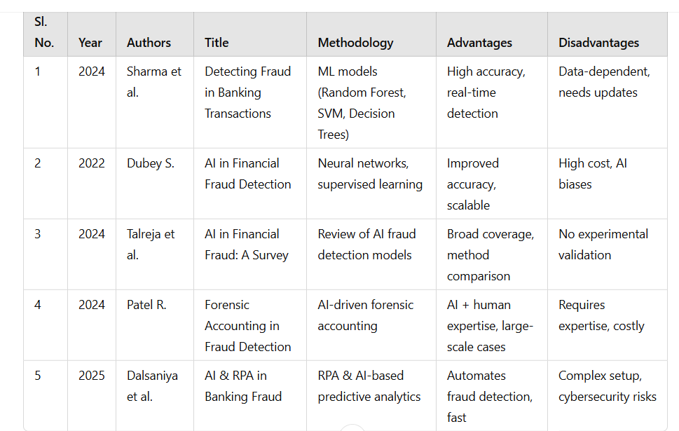
Literature Review

Slide 5
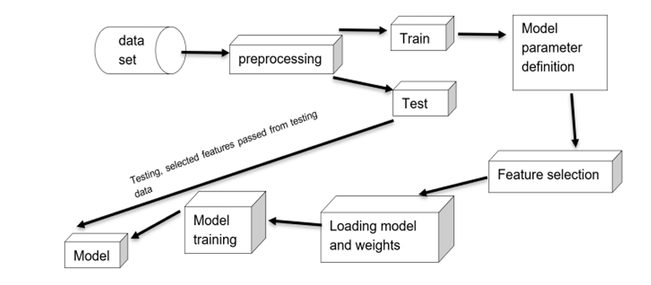
Module Design
Brief overview of the project’s modular architecture
The fraud detection system is designed using a modular architecture to ensure scalability, efficiency, and flexibility. Each module is responsible for a specific function, working together to detect fraudulent transactions in real time.

Slide 6
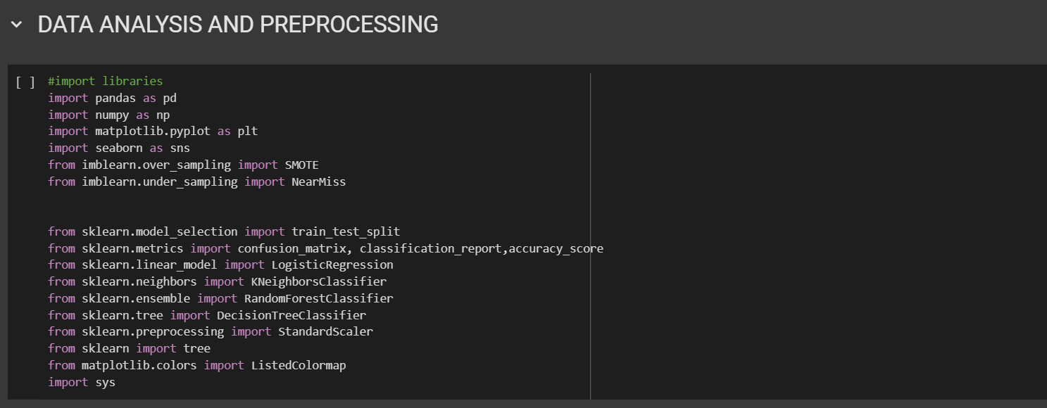
Modular Breakdown
Module 1: Data Analysis and Data Preprocessing
Importance:
Improves model performance by reducing noise in data.

Slide 7
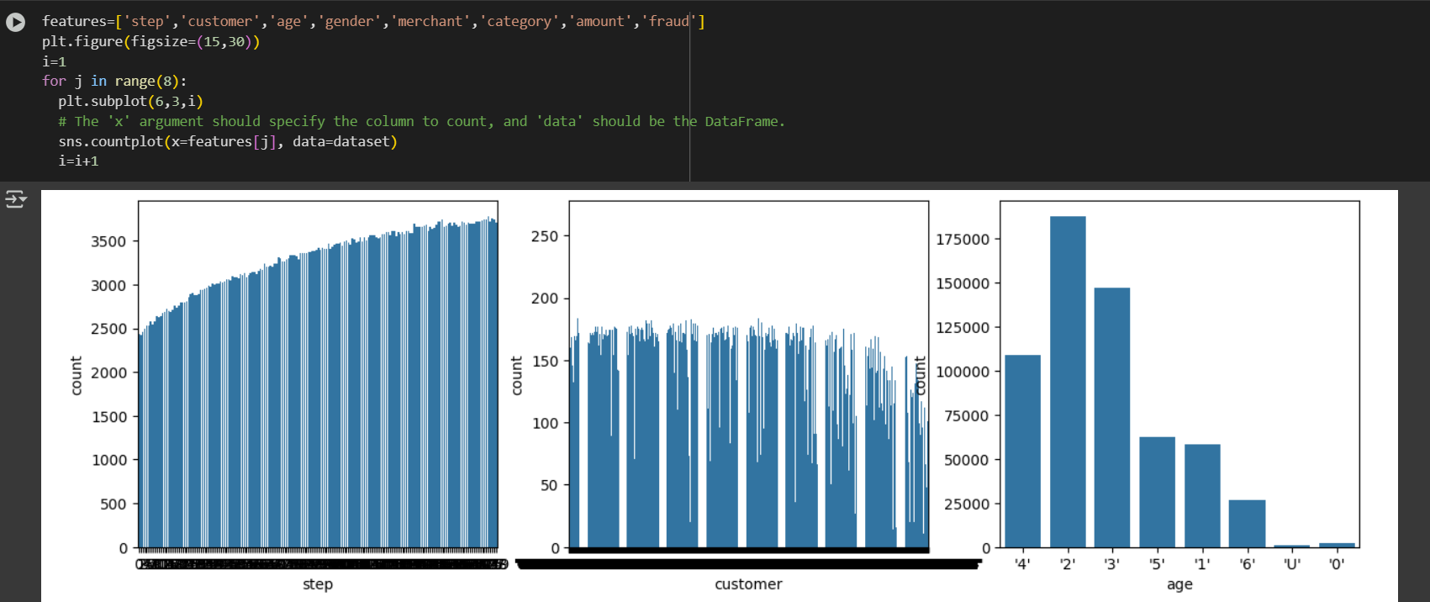
Module 2: Feature Engineering & Selection
Functionality:
Selects the most relevant features for fraud detection models.
Uses statistical methods and ML techniques to enhance detection.
Importance:
Improves fraud detection accuracy by refining critical features

Slide 8
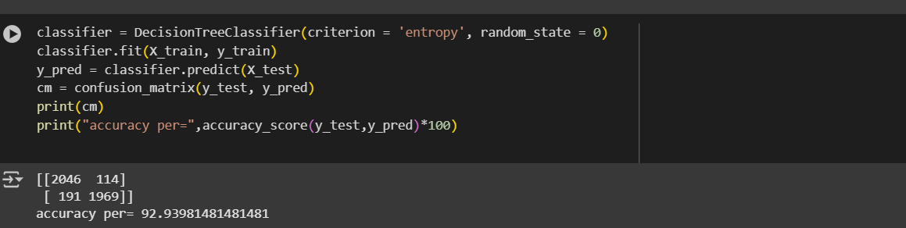
Module 3: Machine Learning-Based Fraud Detection

Slide 9
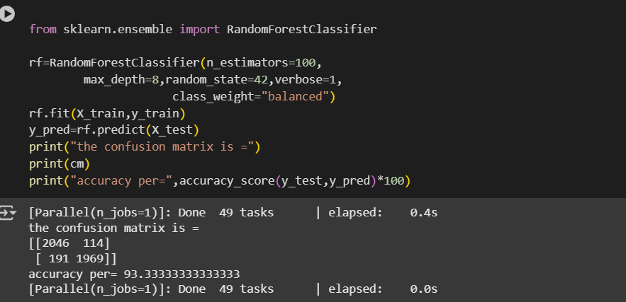

Slide 10
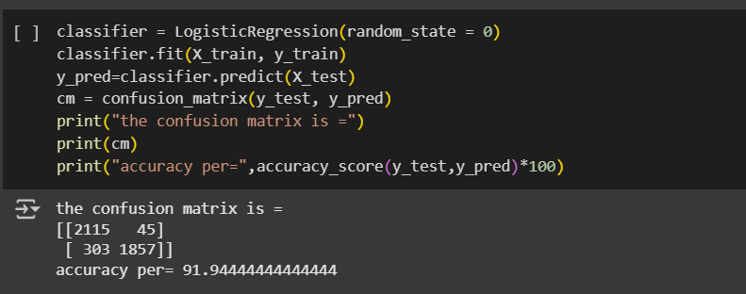

Slide 11
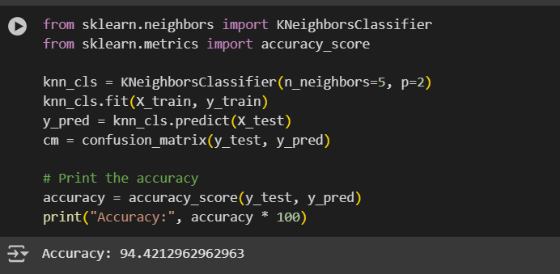

Slide 12
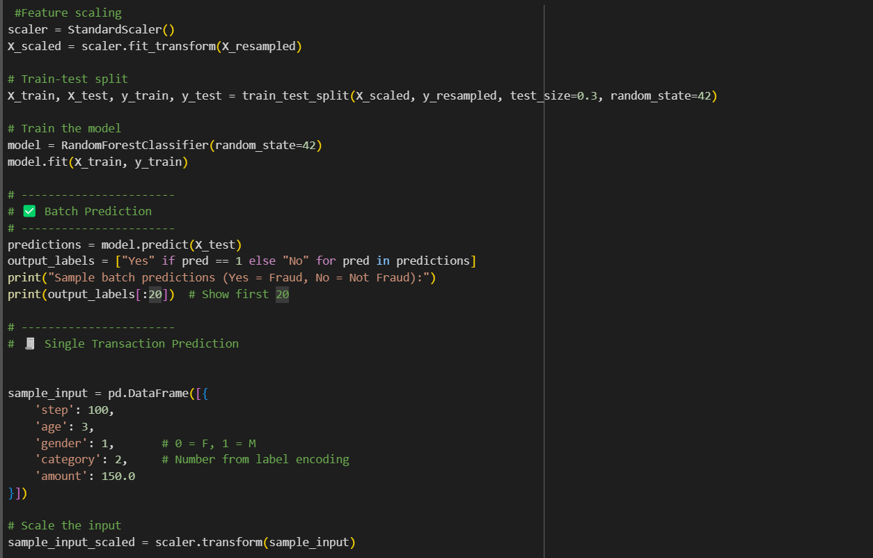
Module 4: Behavioral Analysis and Prediction Results
Functionality:
Implements predefined fraud rules .

Slide 13
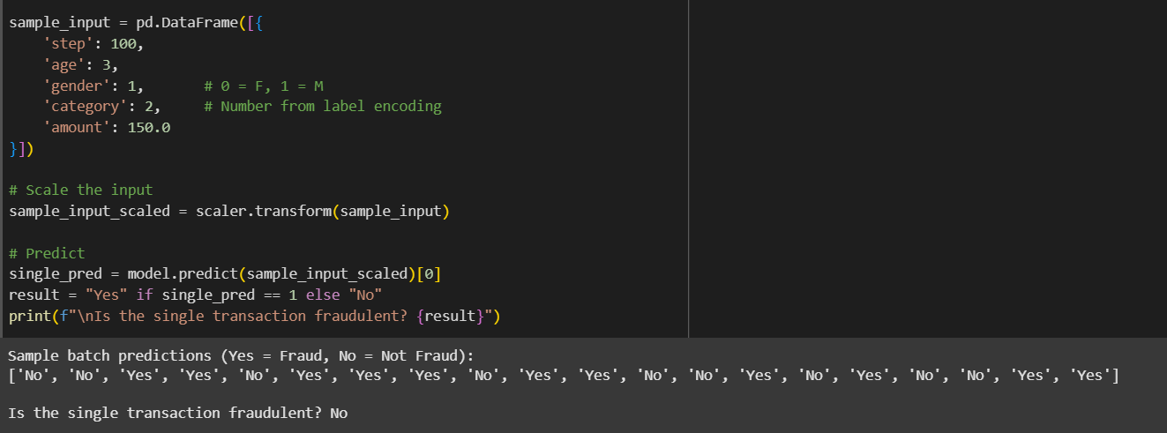

Slide 14
Tools And Technologies To Be Used
1. Development Tools:
Google Colab / Jupyter Notebook – used for coding, testing, and visualizing machine learning models.
2. Programming Language:
Python – The predominant language for implementing machine learning models and data analysis in fraud detection systems..
3. Frameworks & Libraries:
Pandas & Numpy – For data manipulation analysis and numerical computations.
Scikit-Learn -- Offers simple and efficient tools for predictive data analysis.
TensorFlow/Keras -- Used for building and training deep learning models.
4. Additional Tools:
Matplotlib/Seaborn: For creating static, animated, and interactive visualizations.

Slide 15
GITHUB LINK
https://github.com/VijitaNayak/AI-Driven-Fraud-Detection-Banking-Transaction

Slide 16
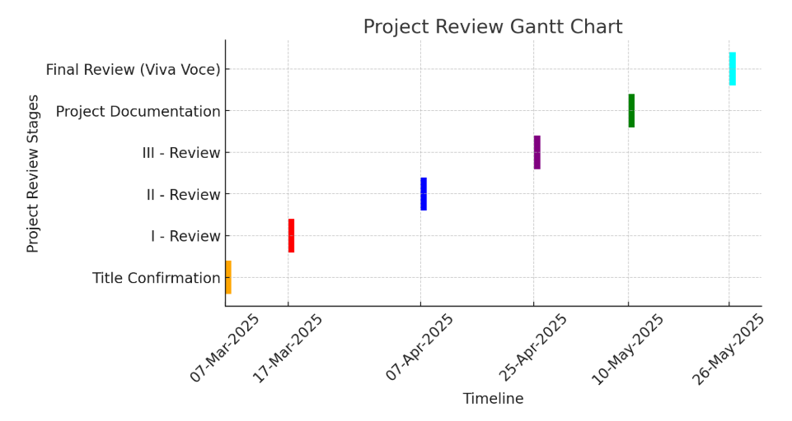
Timeline of the Project

Slide 17
References
M. S. Islam and N. Rahman, "AI-Driven Fraud Detections in Financial Institutions: A Comprehensive Study," Journal of Computer Science and Technology Studies,vol. 7, no. 1, pp. 100–112, 2025.
2. S. Dubey, "Artificial Intelligence in Financial Fraud Detection " Innovative Research Thoughts, vol. 8, no. 4, 2022.
P. Kamuangu, "A Review on Financial Fraud Detection using AI and Machine Learning," Journal of Economics, Finance and Accounting Studies, vol. 6, no. 1, pp. 67–77, Feb. 2024.
A. Dalsaniya, K. Patel, and P. R. Swaminarayan, "Challenges and Opportunities: Implementing RPA and AI in Fraud Detection in the Banking Sector," World Journal of Advanced Research and Reviews, vol. 25, no. 01, pp. 296–308, 2025.
S. Kalisetty, C. Pandugula, L. R. K. Sondinti, G. Mallesham, and P. R. S. Rani, "AI-Driven Fraud Detection Systems: Enhancing Security in Card-Based Transactions Using Real-Time Analytics," Journal of Electrical Systems, vol. 20, no. 11s, 2024.

Slide 18


